Slide 1


Cloud-Based Task Management System with Aws Step Function
D. Gayathri Aneesha (2210030177)
Under the esteemed guidance of
Ms. P. Sree Lakshmi
Assistant Professor,
Department of Computer Science and Engineering

Slide 2

Project Overview
Problem: Manual task coordination in businesses often leads to inefficiencies and errors.
Objective: To develop a serverless, automated task management system using AWS Step Functions.
Real-world Relevance: Applicable in real-world enterprise operations to streamline backend processes.

Slide 3
Services Used
AWS Lambda :
Executes logic like processing purchases and refunds.
AWS IAM :
Manages permissions and secure service access.
AWS Step Functions:
Used to create a state machine that orchestrates the task workflow between Lambda functions.

Slide 4
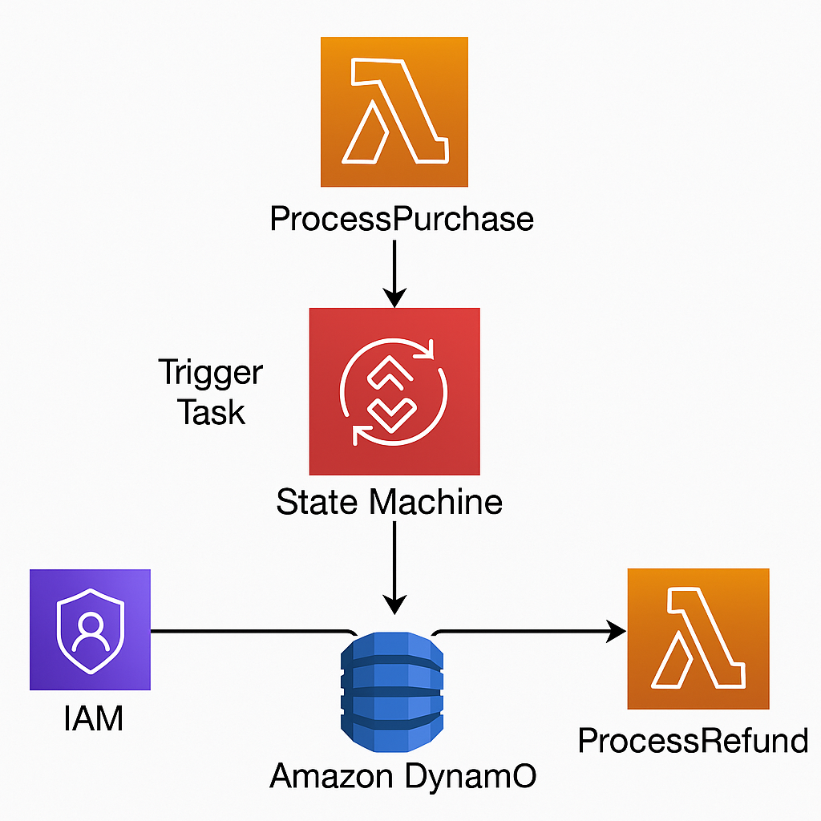
Flow Diagram
Architecture :
Tools used: AWS Console

Slide 5
Implementation Process
Create Lambda Functions
Configure IAM Role
Create Step Function State Machine
Execute the State Machine
Validate Outputs

Slide 6
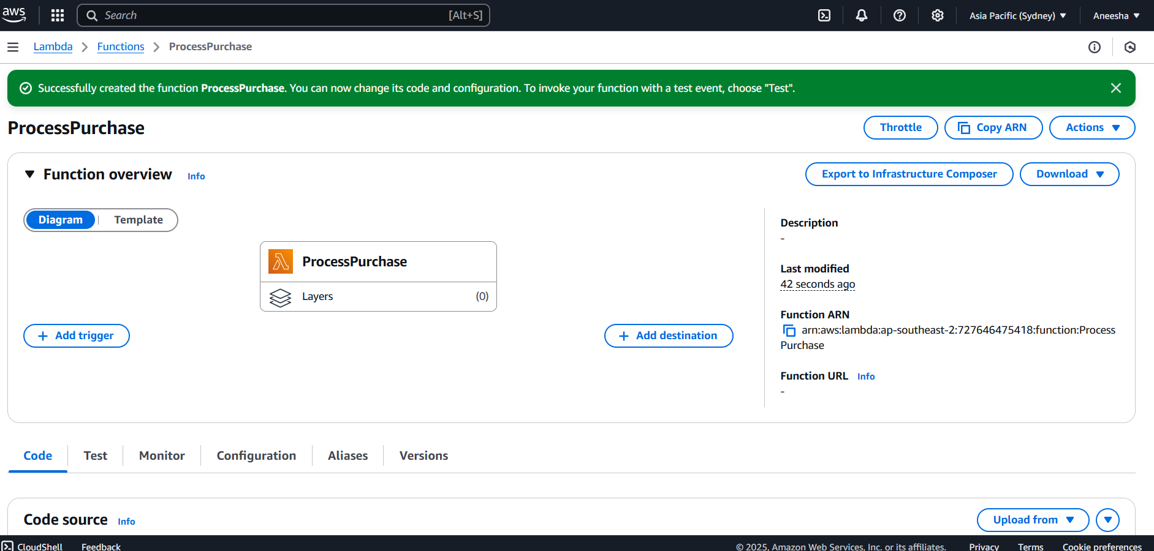
Create Lambda Functions (Process Purchase)

Slide 7
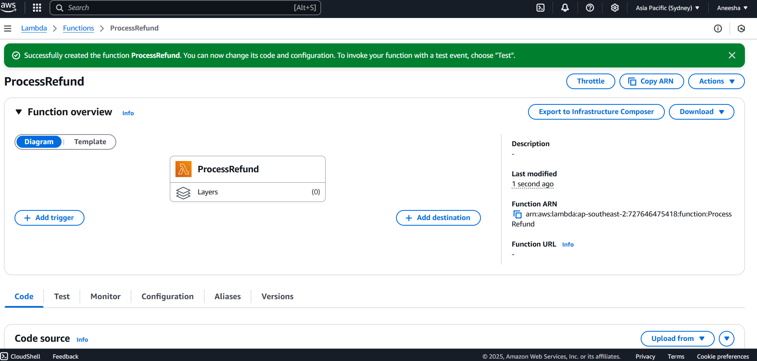
Create Lambda Functions (Process Refund)

Slide 8
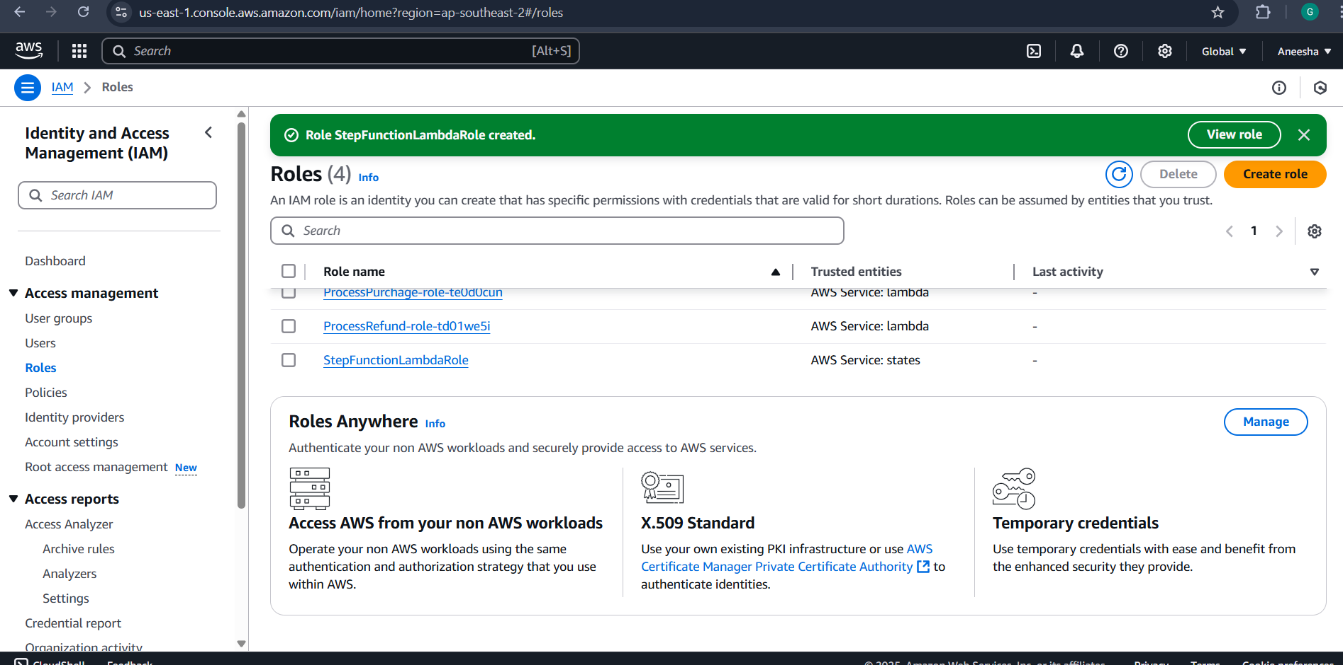
2 . Configure IAM Role:

Slide 9
3.Created Step Function State Machine:

Slide 10
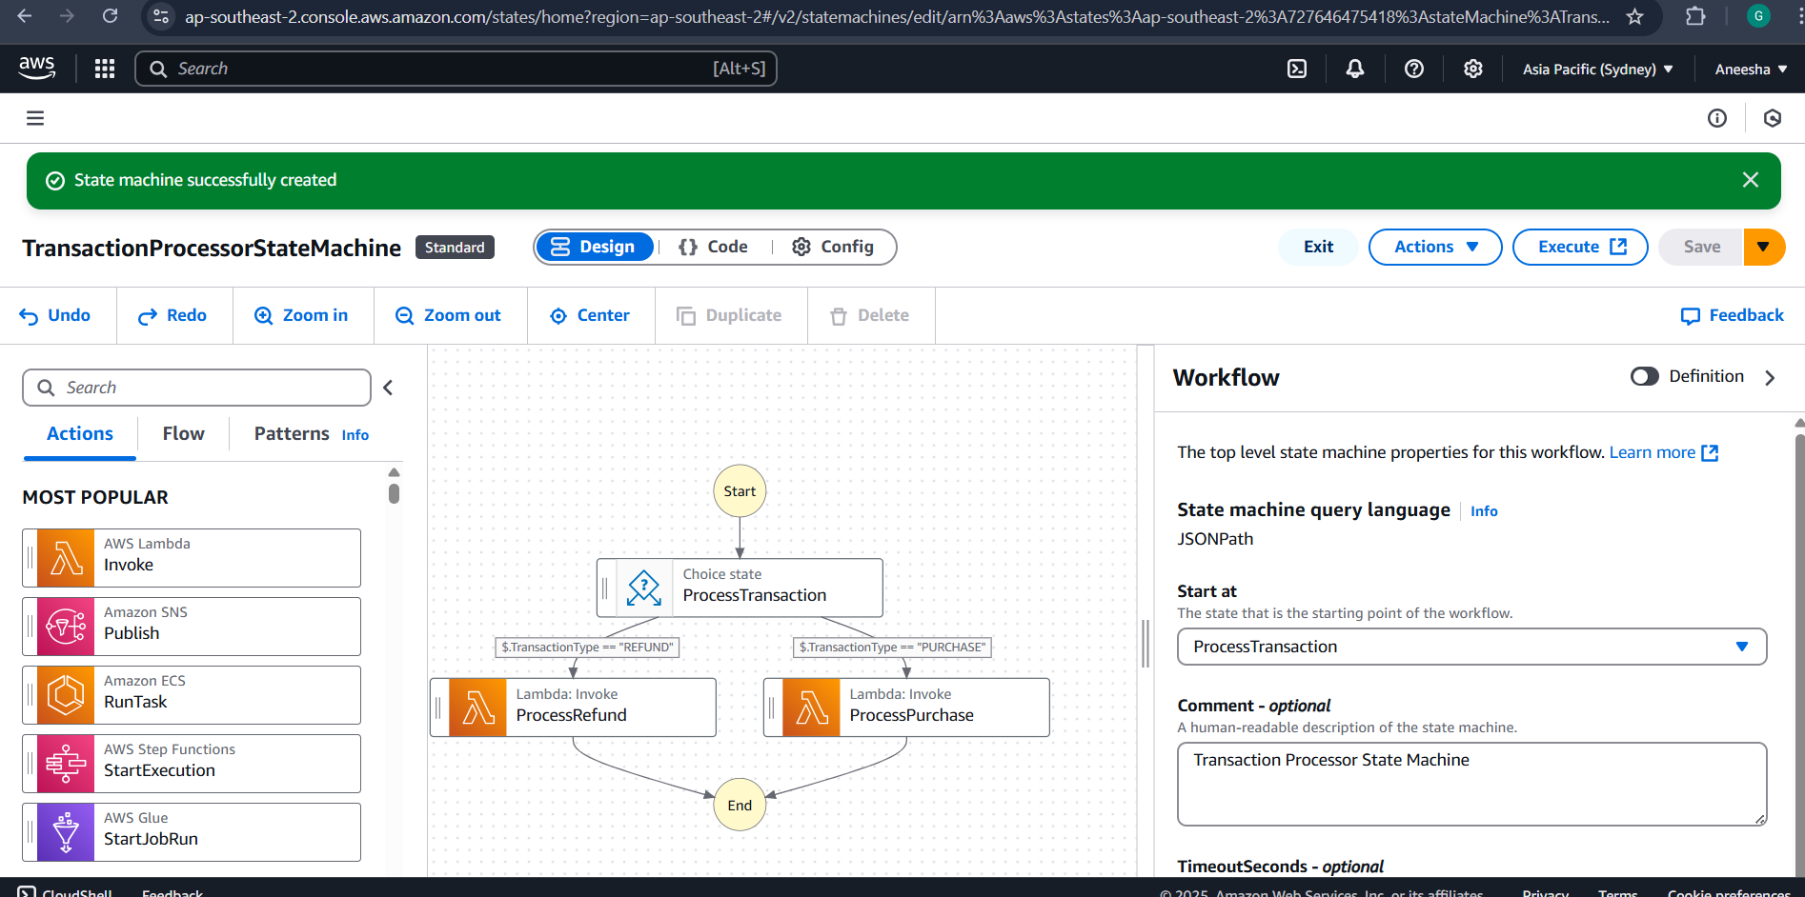
4.Create Step Function State Machine:

Slide 11
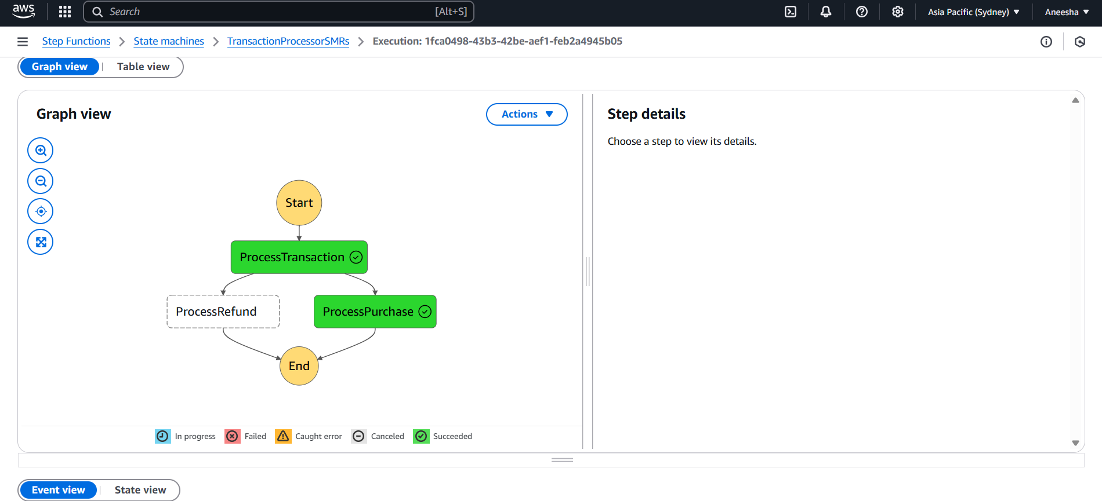
Results and Outputs
Output for purchase process :

Slide 12
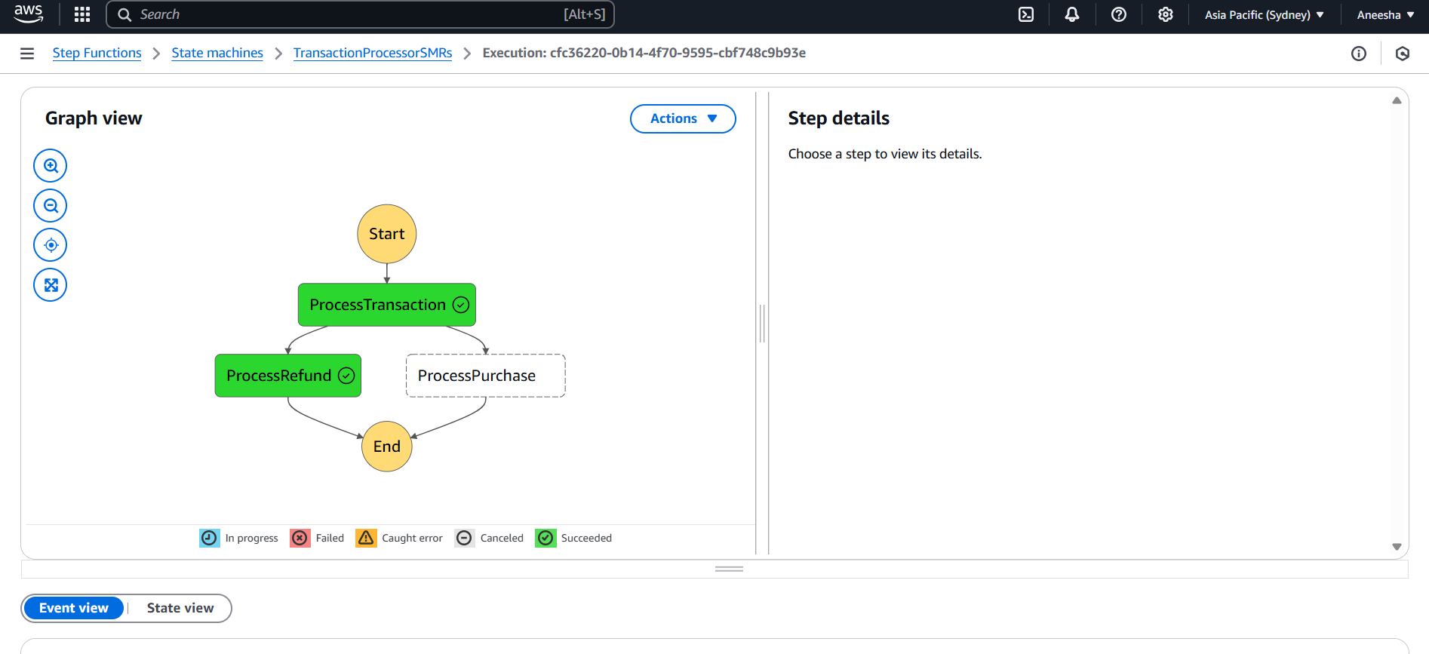
Output for purchase Refund :

Slide 13
Key Features and Functionality
Major Functionalities Implemented:
Serverless task orchestration using AWS Step Functions and Lambda with built-in error handling.
End-User Perspective (UI/Output if Applicable):
Users can track execution flow and outputs directly through the AWS Step Functions Console.
Integration of Multiple AWS Services:
Integrated AWS Lambda, Step Functions, and IAM for secure, event-driven task automation.

Slide 14
Challenges and Solutions
Technical or Conceptual Difficulties:
IAM role configuration errors
Debugging Lambda execution failures
How Challenges Were Resolved:
Followed the least-privilege principle to correct IAM permissions
Tools or Strategies Used for Debugging:
Iterative testing and permission refinement

Slide 15
Learnings & Takeaways
Technical:
Step Functions, Lambda, IAM
Soft Skills:
Debugging, Planning, Documentation
Experience:
Explored AWS certifications and hands-on practice

Slide 16
Future Scope
Possible Extensions or Improvements:
Add a front-end UI for task interaction.
Expand workflows to handle more business logic.
Real-Time Deployment Considerations:
Optimize storage and performance for real-time use.
Deployment for real-time production environments.
Cost Optimization or Scaling Ideas:
Integrate with cost monitoring tools for budget control.

Slide 17
References
[1] AWS Step Functions Documentation:
https://docs.aws.amazon.com/step-functions/latest/dg/welcome.html
[2] AWS Lambda Developer Guide:
https://docs.aws.amazon.com/lambda/latest/dg/welcome.html
[3] AWS IAM Documentation:
https://docs.aws.amazon.com/IAM/latest/UserGuide/introduction.html
[4] AWS General Documentation:
https://docs.aws.amazon.com/

Slide 18
THANK YOU

